Slide 1
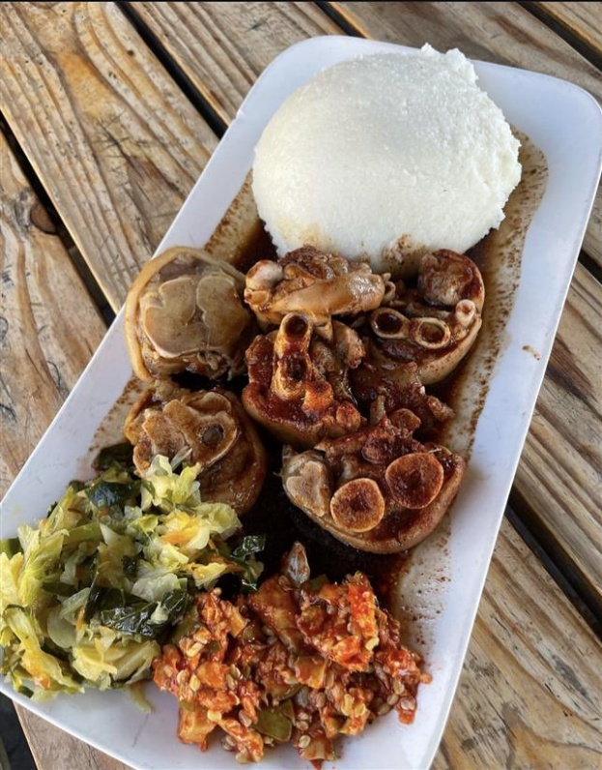
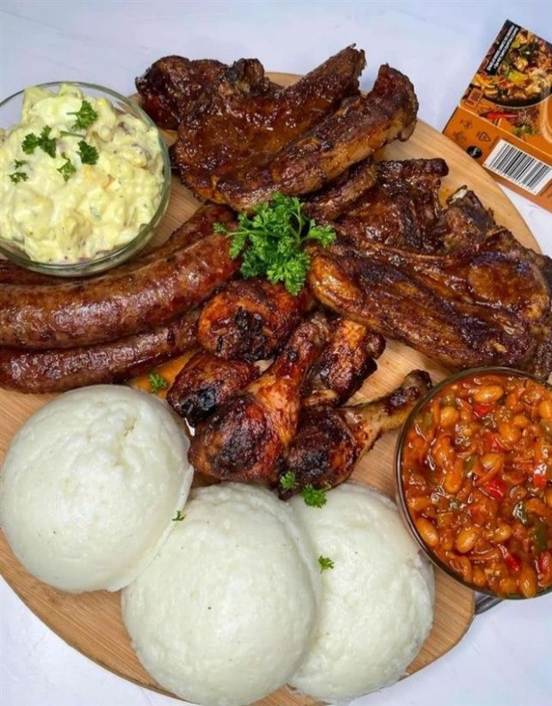
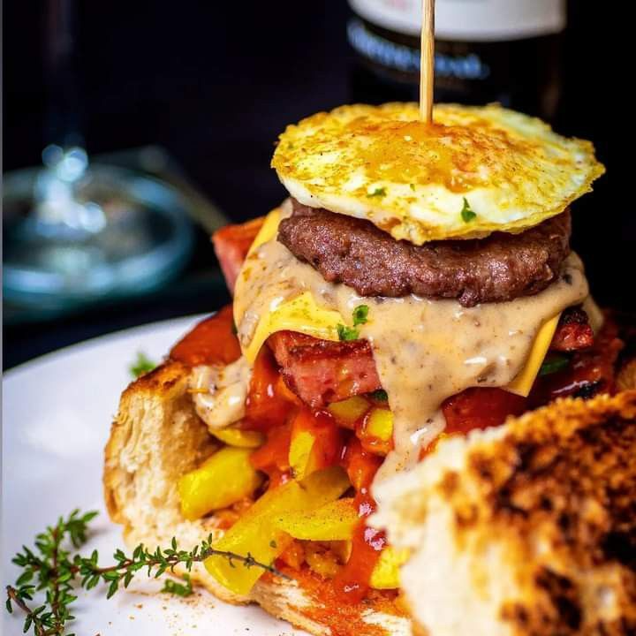
GAULOFUSION Connecting Local Food Businesses to Customers
Presented by Nombulelo Olifant, Sukoluhle Ndlovu, Kutlwano Kuape, Duduzile Mgcina, Thandazile Ncamiso
Notes:
NOTE: To replace a picture, just select and delete it. Then use the Insert Picture icon to replace it with one of your own!

Slide 2

The Problem
Many local food businesses lack digital visibility.
Customers struggle to discover nearby fast food, drinks, or African cuisine spots
Ques are long when they get there.
Events often miss targeted audiences due to poor promotion.
Manual orders and cash payments delay efficiency.

Slide 3

Our Solution: Gaulofusion
A digital platform that:
Connects local fast food, drinks, and African cuisine vendors to customers.
Only accepts secure card payments – no cash.
Includes an events section to promote food-related events and experiences.
Integrates a chatbot with help center support and live order tracking.

Slide 4



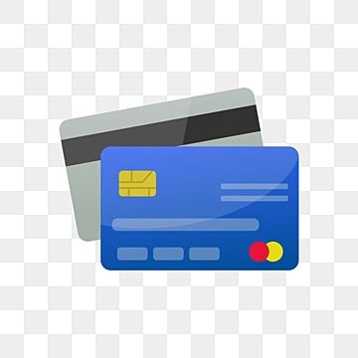
Core Features
Vendor Listings: Local food businesses by category.
Card-Only Payments: Safe, cashless transactions.
Events Section: Local food events, pop-ups, and promotions.
Chatbot Assistant:
Help center support
Order status updates
View current/past orders

Slide 5
User Flow – How It Works
Users browse or search vendors by category.
Add meals/drinks to cart.
Checkout using card payment only.
Get real-time updates via chatbot.
Explore upcoming events or RSVP.
1. Browser the menu
2. Place an order
3. Checkout
4. Updates via chatbot5
5. Events

Slide 6


Target Audience
Food lovers looking for African and local cuisine
Busy professionals wanting quick and reliable ordering
Local food vendors needing an online presence
Event organizers in the culinary space

Slide 7

Technology Stack
Frontend: HTML, CSS, JavaScript
Backend: Firebase
Payments: Paystack (card-only support)
Chatbot: Dialogflow
Database: Firestore
Events Calendar: Custom build

Slide 8
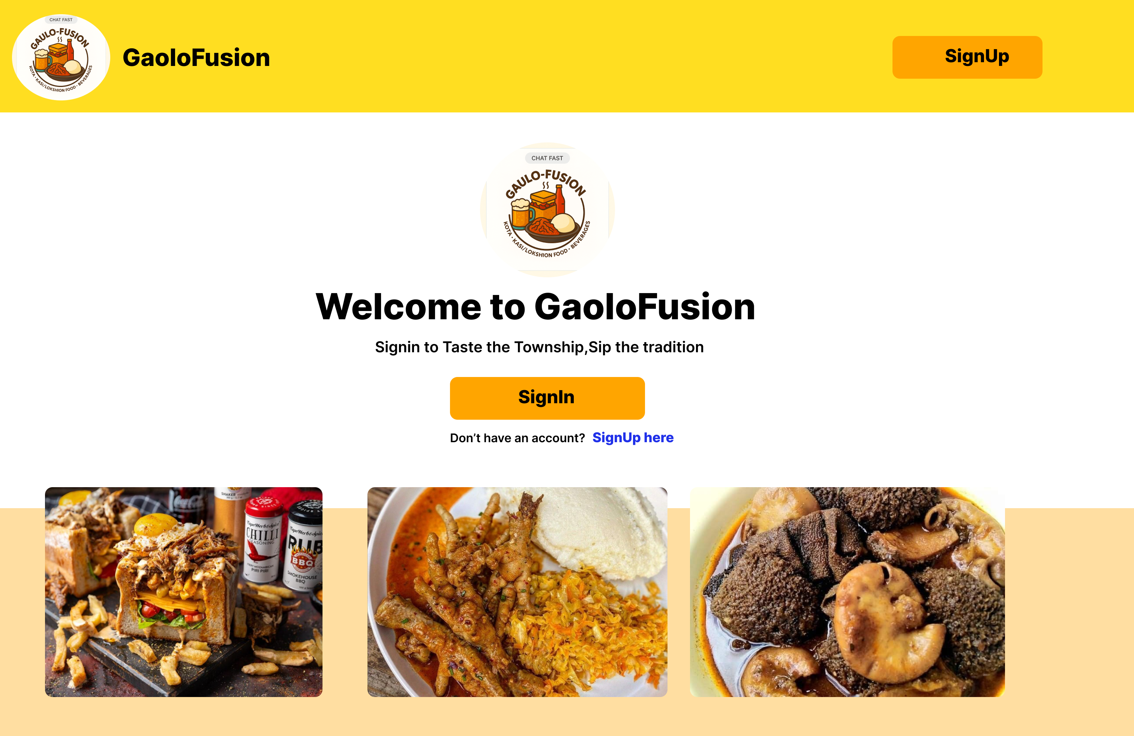
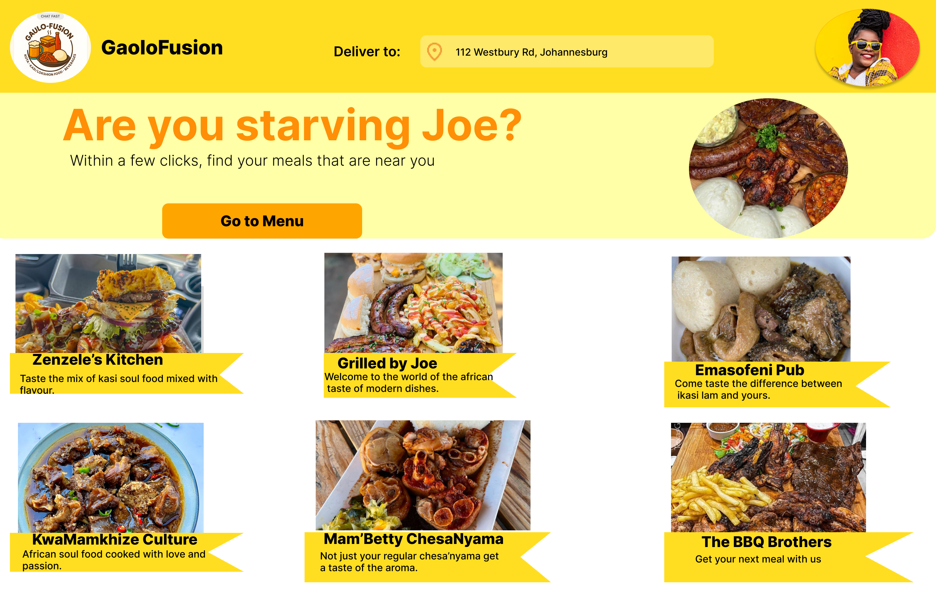
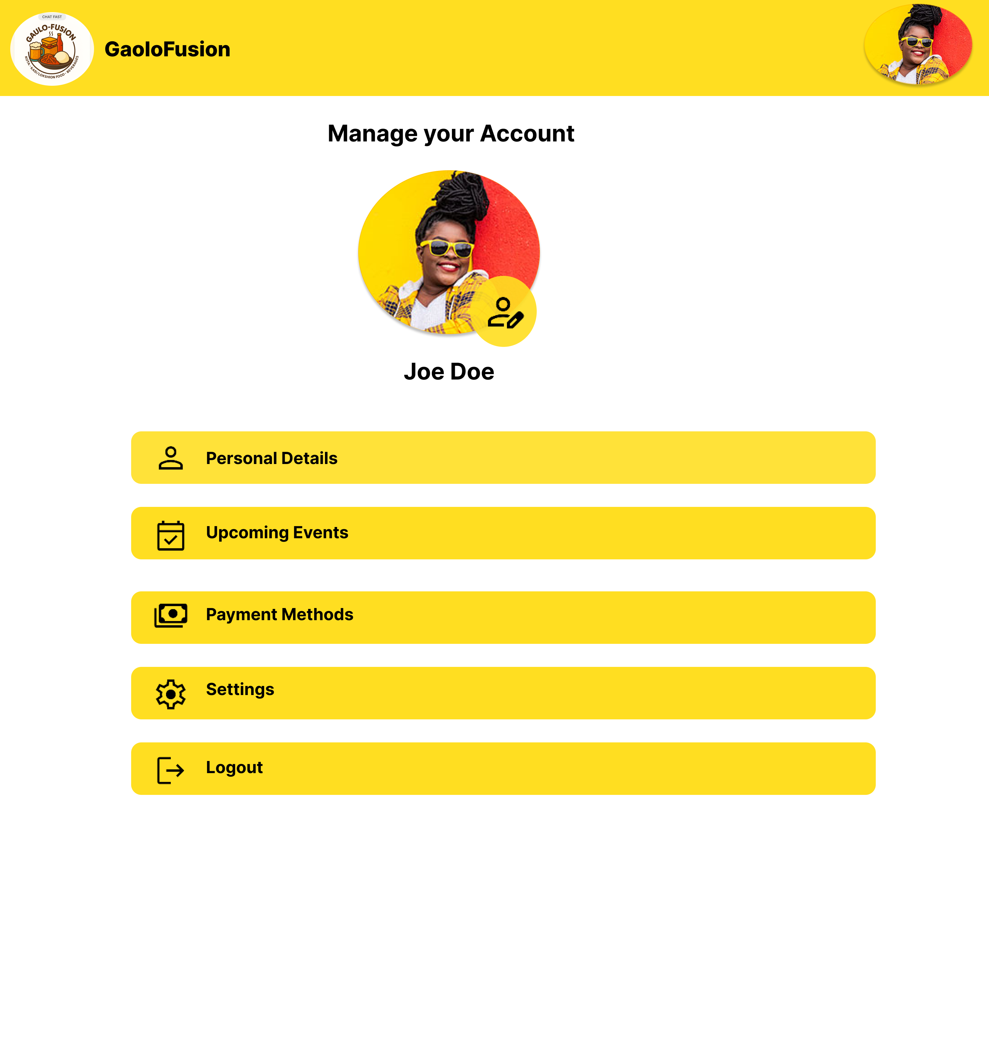
Figma Mockups

Slide 9

Monetization & Sustainability
Vendor subscription plans
Event promotions & ads
Commission per order
Future: Loyalty rewards and partner deals

Slide 10

Future Enhancements
Develop mobile app (iOS & Android)
Add AI-powered food and vendor recommendations
Create vendor dashboards for managing menus and sales
Integrate delivery partner tracking
Support multiple African languages
Launch customer loyalty and rewards program
Introduce subscription-based meal plans
Upgrade chatbot with voice commands and booking support
Strengthen payment security and vendor verification
Build admin analytics dashboard for platform insights

Slide 11
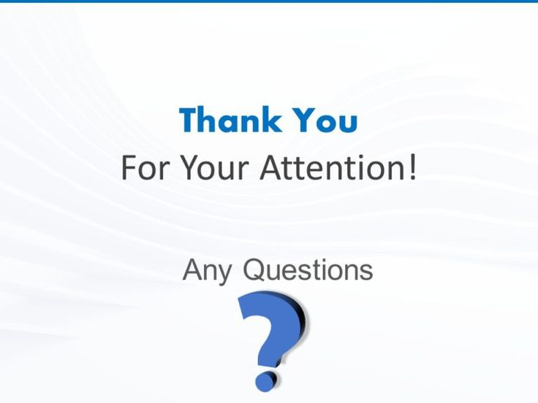
Thank You / Q&A
Have questions? We’re here for them!

